Slide 1
Lecture 5.0 Product Differentiation

Slide 2
Outline
5.0 Product differentiation
5.1 Horizontal product differentiation
5.2 Preemption
5.3 Pricing complementary products

Slide 3
Reading
Chapter 4, ”Differentiation” in McAfee (2002) Competitive Solutions
A link to this chapter is in the Week 5 reading page on Canvas.

Slide 4
Value Creation
Think of value as the sum of producer and consumer surplus.
Net value to consumer is (Willingness to Pay minus Price), i.e. consumer surplus.
Net value to seller is (Price minus marginal cost), i.e. Producer surplus
Hence total value equals (Willingness to Pay minus marginal cost), i.e. Total Surplus.
It is important to note how to think about willingness to pay.
For consumers it reflects the utility derived from consumption of good or service.
For business buyers it reflects the next best alternative: e.g. sugar versus corn syrup in soft drink production
As we have already considered in the context of pricing, it is important to note that Willingness to Pay will vary over buyers

Slide 5
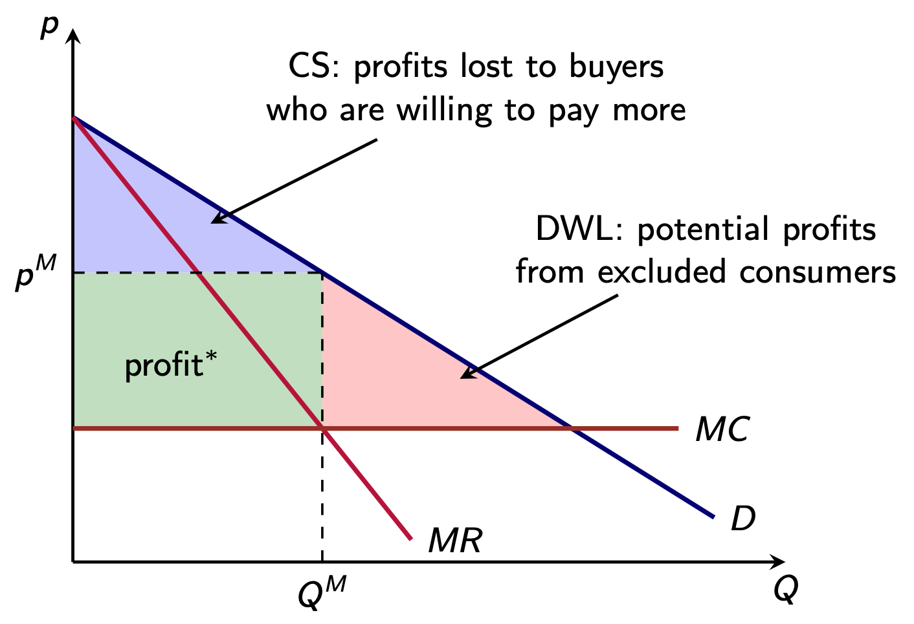
Value Creation
Recall this diagram from last week.

Slide 6
Product Differentiation
The question for a firm is how can they capture more of the value.
One strategy to capture value is product differentiation
By making your self different or creating some uniqueness, i.e. offering a product no one else sells.
By doing so you create some market power.
This could come through market entry or it could come from creating a new product in an existing market

Slide 7
Product Differentiation
Competing products often have distinguishing characteristics
physical differences
perceived differences (e.g. pharmaceuticals, home brands)
service quality
location
Product differentiation alters the strategic interaction between firms
product differentiation provides firms with market power
firms have downward sloping demand curves
one explanation for pricing above marginal cost

Slide 8
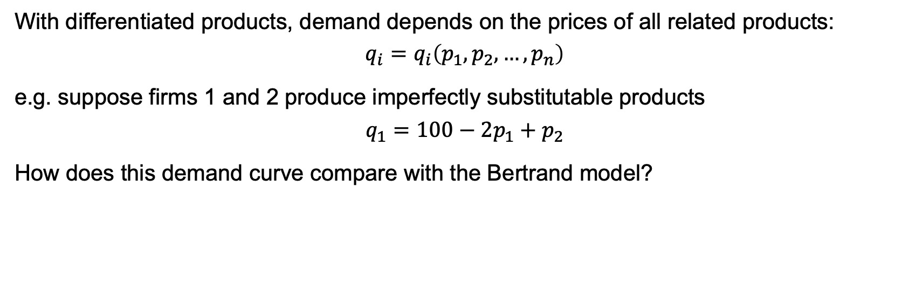
Price competition with differentiated products
With differentiated products, demand depends on the prices of all related products:
$$q_{i}=q_{i}\left(p_{1},p_{2},…,p_{n}\right)$$
e.g. suppose firms 1 and 2 produce imperfectly substitutable products
$$q_{1}=100−2p_{1}+p_{2}$$
How does this demand curve compare with the Bertrand model?

Slide 9
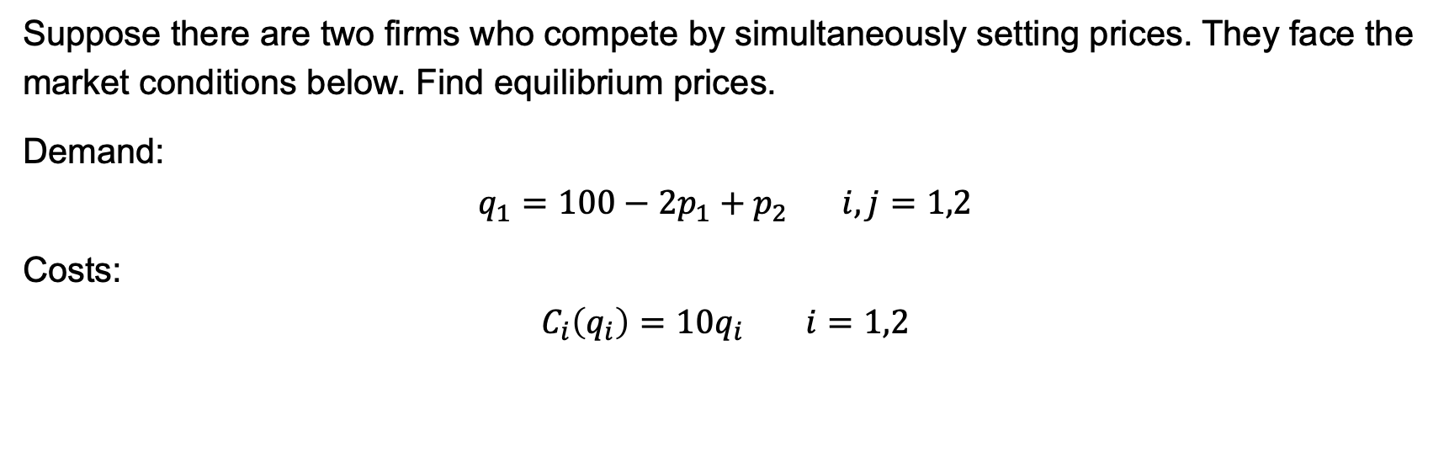
Price competition with differentiated products
Suppose there are two firms who compete by simultaneously setting prices. They face the market conditions below. Find equilibrium prices.
Demand:
$$q_{1}=100−2p_{1}+p_{2} i,j=1,2$$
Costs:
$$C_{i}\left(q_{i}\right)=10q_{i} i=1,2$$

Slide 10
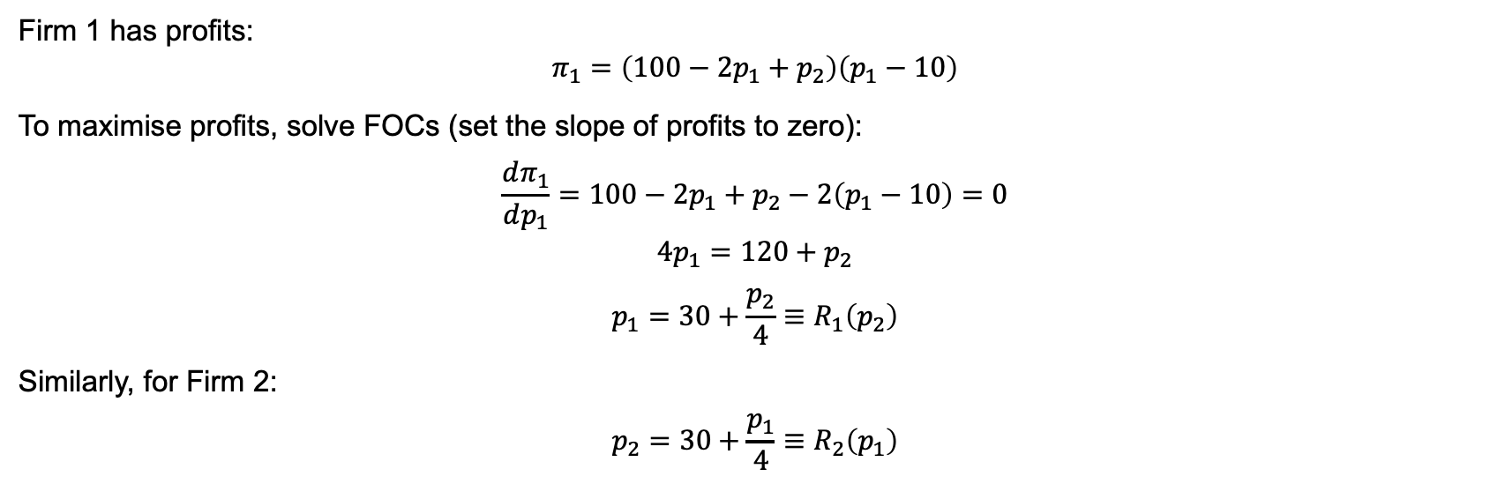
Price competition with differentiated products
Firm 1 has profits:
$$π_{1}=\left(100−2p_{1}+p_{2}\right)\left(p_{1}−10\right)$$
To maximise profits, solve FOCs (set the slope of profits to zero):
$$\frac{dπ_{1}}{dp_{1}}=100−2p_{1}+p_{2}−2\left(p_{1}−10\right)=0$$
$$4p_{1}=120+p_{2}$$
$$p_{1}=30+\frac{p_{2}}{4}≡R_{1}\left(p_{2}\right)$$
Similarly, for Firm 2:
$$p_{2}=30+\frac{p_{1}}{4}≡R_{2}\left(p_{1}\right)$$

Slide 11
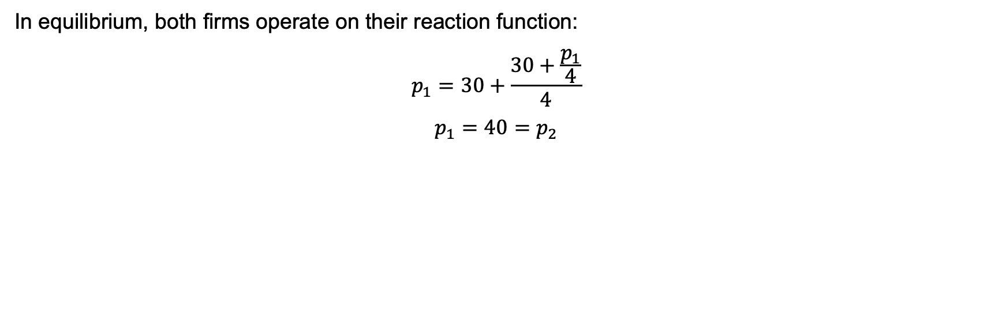
Price competition with differentiated products
In equilibrium, both firms operate on their reaction function:
$$p_{1}=30+\frac{30+\frac{p_{1}}{4}}{4}$$
$$p_{1}=40=p_{2}$$

Slide 12
Types of differentiation
Horizontal differentiation
Consumers have different product rankings
e.g. red BMWs and blue BMWs
Could think about horizontal differentiation as a choice over location
Vertical differentiation
Consumers agree on the ranking of products
Consumers have different preferences for quality
e.g. new BMWs and used Toyota Corollas

